Slide 1



Safe Sport – Nova Scotia Landscape
Mike Hudson – Sport and Recreation Lead, CCTH
902-222-9316 @mike.hudson@novascotia.ca www.coachingNS.ca

Slide 2
Purpose of the session
To share the current Safe Sport landscape in NS and see how the current practice can inform policy and practice in the recreation sector.
Who is in the room ?

Slide 3
Mentimeter
Menti.com
2705 2671

Slide 4
Question 1
What does Safe Sport Mean to you ?

Slide 5
What is Safe Sport
A lot of what we hear now includes:
  Abuse
  Harassment
  Discrimination
  Bullying
  Hazing
  Maltreatment

Slide 6
What Does “Safe” Mean
In a Sport and Recreation Context, arguably, “Safe” means:
  Inclusive
  Welcoming
  Diverse
  Accessible
  Fun
Notes:
https://sportnovascotia.ca/safe-sport-ns/

Slide 7
History
2019
Red Deer declaration
Sport Canada funds SDRCC, OSIC
  NSO’s to commit to independent 3rd party mechanism – tied to funding agreements
  Sport Canada
2022
P/T governments commit to signing on to a 3rd party mechanism in 2023.

Slide 8
Vicarious Liability
COACH/LEADER & VOLUNTEER
PTSO
NSO
LSO
PARTICIPANT
Notes:
Vicarious Liability - Legal Opinion Summary for CAC– Gowling LLB. (See slide 10)
Indirect risk = organization being held responsible for the misconduct of another party because of the relationship that exists between them.
National Sport Organizations can be held responsible for the misconduct of coaches because of the relationship that exists between them. Case law has also shown vicarious liability based upon volunteer actions. Damages awarded for abuse of vulnerable victims are on the rise.
Failure to take steps to prevent sexual abuse from occurring may lead to vicarious liability. Sport organizations without proper protocols in place may provide an environment in which certain individuals in a position of power (coaches) may have the opportunity to be alone with young athletes.
Organizations must take steps to avoid potential risks to the community. This requirement becomes increasingly important if similar organizations are moving towards best practices that have been shown to reduce risks.
The Responsible Coaching Movement provides leadership in best practices.

Slide 9
Safe Sport
Independent Complaints Process for Maltreatment
Education of Stakeholders
Concussion Awareness
Restorative Approaches
Racism and Equality in Sport
Policy and Practice

Slide 10
MALTREATMENT
Maltreatment – a volitional act and/or omission … that results in harm or has the potential for physical or psychological harm.
Types of Maltreatment (include):
  Physical Maltreatment
  Neglect
  Psychological Maltreatment
  Sexual Maltreatment
  Grooming
  Discrimination

Slide 11
Independent “Third Party” Complaints Process
The Landscape
There was no independent “third party” mechanism for dealing with maltreatment complaints in the sport system in NS
Developments
NSO
P/T Governments committed to having a third -arty mechanism for maltreatment in sport by the end 2023.
Sport NS has become the first provincial signatory with the Office of The Sport Integrity Commission (OSIC)
All complaints that are considered Maltreatment will be dealt with by a third-party mechanism.
The cost of dealing with the complaint will be paid for by Sport NS.
Complaints that fall outside the OSIC process will be dealt with by the PSO existing complaints and discipline policy.

Slide 12
Complaints in the Sport System – Our Vision
Egregious Breaches of the Maltreatment Code (UCCMS)
Dealt with by the criminal justice system or
Other Breaches of the Maltreatment Code
Dealt with through a restorative justice approach where healing and learning is the outcome – not traditional punitive sanctions.
Field of Play Complaints (None Maltreatment)
Dealt with by the PSOs/CSOs existing complaints policy
Restorative approaches can be adopted here where appropriate
The OSIC “Third Party Mechanism”
Dealt with through the OSIC “Third Party Mechanism” or

Slide 13
Background Screening and Education Requirements
The Landscape
Background screening and education requirements for sport and recreation leaders are inconsistent and somewhat misunderstood by the sector. Very few organizations have the ability to track effectively screening and education requirements of their sport leaders.
What’s Coming
All coaches, managers, officials and board members – mandatory screening – EPIC – every three years
Assist PSOs with safe sport management/tracking/compliance – Sideline Learning
Exploring the cost of subsidizing the EPIC check

Slide 14
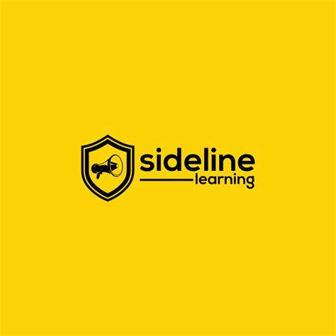
Sideline Learning

Slide 15
Education and Training
The Landscape
Comprehensive and clear safe sport education exists, however, the programs tend to focus on different aspects of safe sport
There are different motivations for requiring safe sport education (e.g., NCCP compliance, funding, NSO requirements, liability)
Education has been traditionally primarily targeted towards coaches
What’s coming
Mandate minimum standards of consistent safe sport education based on role (including education offered to parents, athletes, officials, board members etc.) .
NCCP compliance
Use CAC’s 90 minute, free, safe sport education module as a minimum requirement for all coaches, managers, officials, board members.
Adopted as part of Sport NS Safe Sport Policy Suite

Slide 16
Policy and Practice
The Landscape
Organizations safe sport policies are inconsistent. Some are NSO documents that have been adopted. Some have policies that include dispute resolution process. In other cases there is no process outlined that could be implemented to deal with PSO disputes.
What’s coming
Safe Sport Policy Suite including a stand alone UCCMS.
Implementation of the policy suite will be required to be part of the third-party OSIC process.

Slide 17
Concussion Awareness
Levels of Concussion awareness in Nova Scotia where not high in the Sport and Recreation Sector.
Partnered with the Brain Injury Association of NS to create an action plan to increase awareness with sport and recreation stakeholders,
Web site created to share consistent protocol on concussion management.
Parent and athlete/participant e-module created to help inform Nova Scotians.

Slide 18
Other Safe Sport Work
Anti Racism week – Free E-learning module for parents and athletes and parents launched November 2022
Women and Girls – NS is developing an action plan in response to Women in Sport Report. Board make up.
Restorative Justice - Continued work with restorative justice lab at Dal
True Sport - Athlete Ambassador Program

Slide 19
Closing Question
Is there anything you learned today that you think has significance or value for the recreation sector.

Slide 20


